Slide 1
Data Mining Topic: Nearest Neighbor Classifiers
Dr. J Angel Arul Jothi
Department of Computer Science

Slide 2
Text Book Chapter 5
Section 5.2

Slide 3
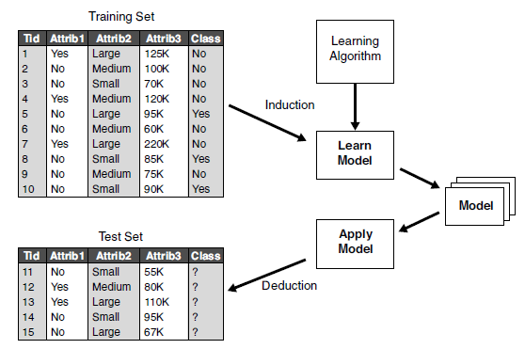
Classification framework
inductive step construct classification model from data
deductive step apply the model to test examples

Slide 4
Types of learners
Eager Learners
When the training data is supplied eager learners learn a model that maps the input attributes to the class label Example: Decision trees and rule-based classifiers
Lazy Learners
During training, the training examples are just stored
During testing, the stored training samples are used to classify the test samples
Instance based learners

Slide 5
Examples of lazy learners
Rote-learner
Memorizes entire training data
When a test record is supplied, perform classification only if attributes of test record match one of the training examples exactly
Some test records may not be classified because they do not match any training example
Nearest neighbor
Uses k “closest” points (nearest neighbors) for performing classification

Slide 6
Nearest neighbor classifier
Basic idea:
If it walks like a duck, quacks like a duck, then it’s probably a duck
Compute Distance
Test Record
Training Records
Choose k of the “nearest” records

Slide 7
Nearest neighbor classifier
A nearest neighbor classifier represents each example/records as a data point in a d-dimensional space, where d is the number of attributes
Requires three things
The set of labeled records
Distance metric to compute distance between records
The value of k, the number of nearest neighbors to retrieve

Slide 8
Nearest neighbor classifier
To classify an unknown (test) record:
Compute distance of the test record to other training records
Sort the distances in increasing order
Identify k minimum distances (nearest neighbors)
Use class labels of nearest neighbors to determine the class label of unknown record (e.g., by taking majority vote)

Slide 9
Nearest neighbor classifier
K-nearest neighbors of a record x are data points that have the k smallest distance to x

Slide 10
Nearest neighbor classifier
Example: Consider the following dataset. Use 3NN classifier and Euclidean distance metric to classify the test record t whose attribute values are as follows:
Attribute1 =3, Attribute2 = 7, Class label = ?
Attribute1 | Attribute2 | Class label
7 | 7 | No
7 | 4 | No
3 | 4 | Yes
1 | 4 | Yes

Slide 11
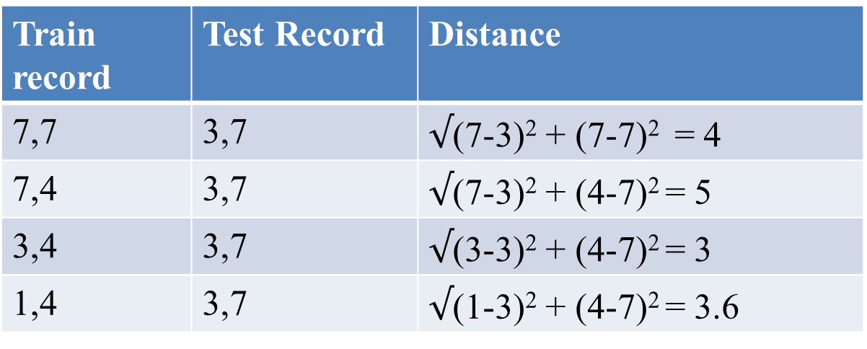
Nearest neighbor classifier
Example: Consider the following dataset. Use 3NN classifier and Euclidean distance metric to classify the test record t whose attribute values are as follows: Attribute1 =3, Attribute2 = 7, Class label = ?
Step 1: Compute the distance between the test record and training samples
Train record | Test Record | Distance
7,7 | 3,7
7,4 | 3,7
3,4 | 3,7
1,4 | 3,7

Slide 12
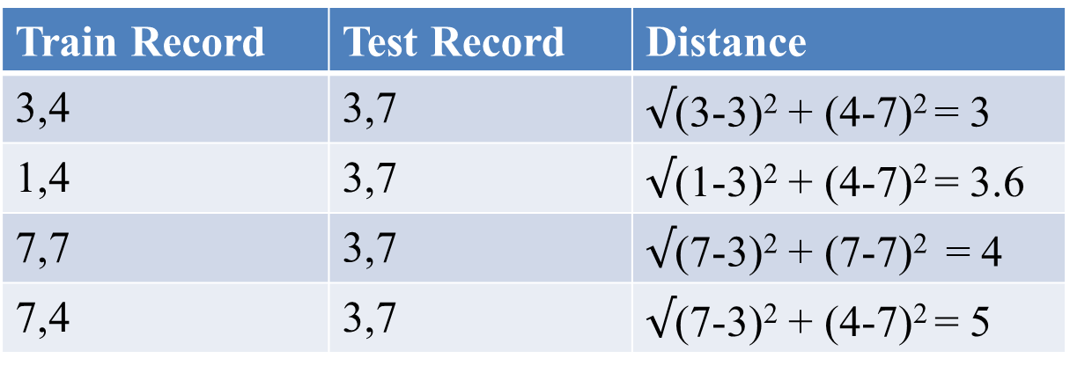
Nearest neighbor classifier
Example: Consider the following dataset. Use 3NN classifier and Euclidean distance metric to classify the test record t whose attribute values are as follows: Attribute1 =3, Attribute2 = 7, Class label = ?
Step 2: Arrange the distances in increasing order
Train Record | Test Record | Distance
3,4 | 3,7
1,4 | 3,7
7,7 | 3,7
7,4 | 3,7

Slide 13
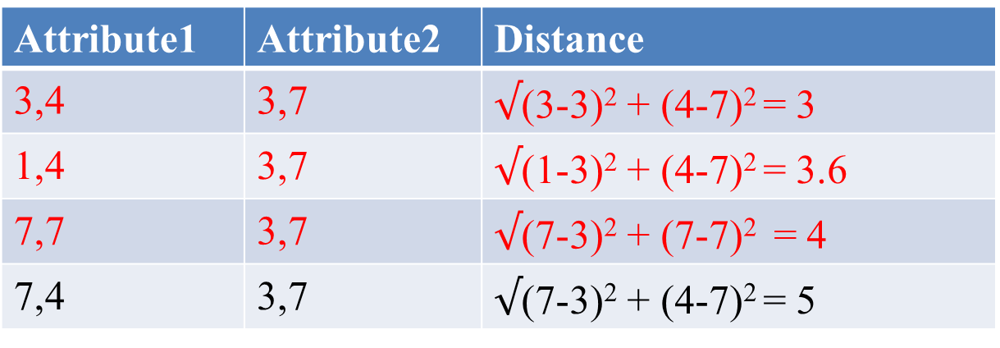
Nearest neighbor classifier
Example: Consider the following datatset. Use 3NN classifier and Euclidean distance metric to classify the test record t whose attribute values are as follows: Attribute1 =3, Attribute2 = 7, Class label = ?
Step 3: Choose 3 (minimum distance) nearest neighbors
Train Record | Test Record | Distance
3,4 | 3,7
1,4 | 3,7
7,7 | 3,7
7,4 | 3,7

Slide 14
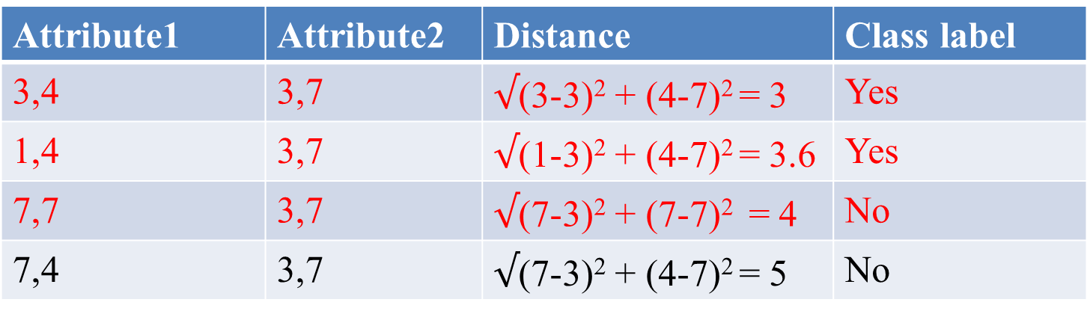
Nearest neighbor classifier
Example: Consider the following datatset. Use 3NN classifier and Euclidean distance metric to classify the test record t whose attribute values are as follows: Attribute1 =3, Attribute2 = 7, Class label = ?
Step 4: Majority voting
Train Record | Test Record | Distance | Class label
3,4 | 3,7 |  | Yes
1,4 | 3,7 |  | Yes
7,7 | 3,7 |  | No
7,4 | 3,7 |  | No
The test sample is given the class label as Yes

Slide 15
Nearest neighbor classifier
Choosing the value of k:
If k is too small, then the nearest-neighbor classifier may be susceptible to noise/spurious data (overfitting)
If k is too large, the nearest-neighbor classifier may misclassify the test instance because its list of nearest neighbors may include data points that are located far away from its neighborhood

Slide 16
Nearest neighbor classifier
Choosing an appropriate value of k
Start with k = 1
Use a test set to estimate the error rate of the classifier
This process can be repeated each time by incrementing k to allow for one more neighbor
The k value that gives the minimum error rate may be selected

Slide 17
Nearest neighbor classifier
Compute distance between two points:
Euclidean distance
L1 (Manhattan), L2, L∞ norms can be explored

Slide 18
Nearest neighbor classifier
Determine the class from nearest neighbor list
Take the majority vote of class labels among the k-nearest neighbors
every neighbor has the same impact on the classification

Slide 19
Nearest neighbor classifier
Nearest-neighbor classifiers can also be used for numeric prediction (regression)
In this case, the classifier returns the average value of the real-valued labels associated with the k-nearest neighbors of the unknown tuple

Slide 20
Nearest neighbor classifier
Normalizing attributes
Attributes may have to be normalized to prevent distance measures from being dominated by one of the attributes which has large value
Ex: features: age, income
Min-max normalization
Z-score

Slide 21
Nearest neighbor classifier
Removing irrelevant and redundant attributes has shown to improve
Classification costs
Accuracy

Slide 22
Nearest neighbor classifier
Distance-weighted nearest neighbor algorithm
Weight the contribution of each of the k neighbors x_{i} according to their distance to the query point x_{q}
giving greater weight to closer neighbors

Slide 23
Nearest Neighbors
Instances map to points in R^{d}
Less than 20 features (attributes) per instance, typically normalized
Lots of training data
Advantages:
Training is very fast
Do not loose information
Disadvantages:
Slow at query time
Easily fooled by irrelevant features (attributes)

Slide 24
Distance Weighted Nearest Neighbor classifier - Example1
Consider the following dataset. Use distance weighted 3NN classifier and a weighting scheme of the reciprocal of the squared Euclidean distance to classify the test record t whose attribute values are: Attribute1 =3, Attribute2 = 7, Class label = ?. Use Euclidean distance to find the neighbors.
Attribute1 | Attribute2 | Class label
7 | 7 | No
7 | 4 | No
3 | 4 | Yes
1 | 4 | Yes
8 | 5 | No

Slide 25
Distance Weighted Nearest Neighbor classifier - Example1
Train Record | Test Record | EuclideanDistance | Weight (reciprocal of the squared Euclidean distance) | Class label
7,7 | 3,7 | 4 | 1/16 = 0.0625 | No
7,4 | 3,7 | 5 | 1/25 = 0.04 | No
3,4 | 3,7 | 3 | 1/9 =0.11 | Yes
1,4 | 3,7 | 3.60 | 1/13 =0.076 | Yes
8,5 | 3,7 | 5.39 | 1/29 =0.034 | No
Neighbours = (3,4) (1,4) (7,7)
Weight for Yes class = 0.11 + 0.076 = 0.186
Weight for No class = 0.0625
Maximum weight = 0.186. Predicted class for the test record is “Yes”

Slide 26
Distance Weighted Nearest Neighbor classifier – Example2
Consider the following dataset. Use distance weighted 5NN classifier and a weighting scheme of the reciprocal of the squared Euclidean distance to classify the test record t whose attribute values are: Attribute1 =3, Attribute2 = 7, Class label = ?. Use reciprocal of the squared Euclidean distance as weighting scheme
Attribute1 | Attribute2 | Class label
7 | 7 | No
7 | 4 | No
3 | 4 | Yes
1 | 4 | Yes
8 | 5 | No

Slide 27
Distance Weighted Nearest Neighbor classifier – Example2
Train Record | Test Record | Weight(reciprocal of the squared Euclidean distance) | Class label
7,7 | 3,7 | 1/16 = 0.0625 | No
7,4 | 3,7 | 1/25 = 0.04 | No
3,4 | 3,7 | 1/9 =0.11 | Yes
1,4 | 3,7 | 1/13 =0.076 | Yes
8,5 | 3,7 | 1/29 =0.034 | No
Weight for Yes class = 0.11 + 0.076 = 0.186
Weight for No class = 0.0625 + 0.04 + 0.034 = 0.1365
Maximum weight = 0.186. Predicted class for the test record is “Yes”

Slide 28
K-NN Regression – Example 1
ID | WAVE SIZE ((FT) | WAVE PERIOD (SEC) | WIND SPEED
1 | 6 | 15 | 5
2 | 1 | 6 | 9
3 | 7 | 10 | 4
4 | 7 | 12 | 3
5 | 2 | 2 | 10
6 | 10 | 2 | 20
The table represent a dataset that was used to create a 3-NN model to predict
wind speed. Assuming the model uses Manhattan distance to find nearest neighbors, what prediction will the model return for the query instance.
Q1: WAVE SIZE = 8, WAVE PERIOD = 15

Slide 29
K-NN Regression – Example 1
ID | WAVE SIZE ((FT) | WAVE PERIOD (SEC) | DISTANCE | WIND SPEED
1 | 6 | 15 | 2 | 5
2 | 1 | 6 | 16 | 9
3 | 7 | 10 | 6 | 4
4 | 7 | 12 | 4 | 3
5 | 2 | 2 | 19 | 10
6 | 10 | 2 | 15 | 20
Nearest neighbors are IDs 1, 3, 4
Predicted wind speed = (5 + 4 + 3)/3 = 4

Slide 30
K-NN Regression – Example 2
ID | WAVE SIZE ((FT) | WAVE PERIOD (SEC) | WIND SPEED
1 | 6 | 15 | 5
2 | 1 | 6 | 9
3 | 7 | 10 | 4
4 | 7 | 12 | 3
5 | 2 | 2 | 10
6 | 10 | 2 | 20
Consider the dataset given above. Use distance weighted 3-NN classifier and a weighting scheme of the reciprocal of the Manhattan distance to classify the test record. Use Manhattan distance to find the neighbors.
Q1: WAVE SIZE = 8, WAVE PERIOD = 15

Slide 31

K-NN Regression – Example 2
ID | WAVE SIZE ((FT) | WAVE PERIOD (SEC) | DISTANCE | Weight | WIND SPEED
1 | 6 | 15 | 2 | 0.5 | 5
2 | 1 | 6 | 16 |  | 9
3 | 7 | 10 | 6 | 0.17 | 4
4 | 7 | 12 | 4 | 0.25 | 3
5 | 2 | 2 | 19 |  | 10
6 | 10 | 2 | 15 |  | 20
Nearest neighbours are IDs 1, 3, 4
Weight = 0.5, 0.17.0.25
Predicted wind speed = (5*0.5 + 4 * 0.17+ 3*0.25 )/ (0.5 +0.17 + 0.25) = 4.27

Slide 32
K-NN Regression – Example 3
ID | WAVE SIZE ((FT) | WAVE PERIOD (SEC) | WIND SPEED
1 | 6 | 15 | 5
2 | 1 | 6 | 9
3 | 7 | 10 | 4
4 | 7 | 12 | 3
5 | 2 | 2 | 10
6 | 10 | 2 | 20
Consider the dataset given above. Use distance weighted 6-NN classifier and a weighting scheme of the reciprocal of the squared Euclidean distance to classify the test record
Q1: WAVE SIZE = 8, WAVE PERIOD = 15

Slide 33
K-NN Regression – Example 3
ID | WAVE SIZE ((FT) | WAVE PERIOD (SEC) | Weight | WIND SPEED
1 | 6 | 15 | 0.25 | 5
2 | 1 | 6 | 0.007 | 9
3 | 7 | 10 | 0.04 | 4
4 | 7 | 12 | 0.1 | 3
5 | 2 | 2 | 0.004 | 10
6 | 10 | 2 | 0.005 | 20
Final prediction:4.66
Sum (Weight * Wind speed) = 5 * 0.25 + 9 * 0.007 + 4 * 0.04 + 3 * 0.1 + 10 * 0.004 + 20 * 0.005 = 1.25 + 0.06 +0.16+ 0.3+0.04+0.1 = 1.91
Sum Weight = 0.409

Slide 34
Thank you

